Slide 1
Predicting Customer Booking Completion for British Airways
To build a machine learning model that predicts whether a customer will complete a booking based on historical booking data and behavior patterns.
Kaustubh Sawant

Slide 2
Approach
Cleaned and prepared customer booking dataset (14 features, no missing data)
One-hot encoded categorical variables
Trained a Random Forest Classifier
Evaluated using confusion matrix and classification report

Slide 3
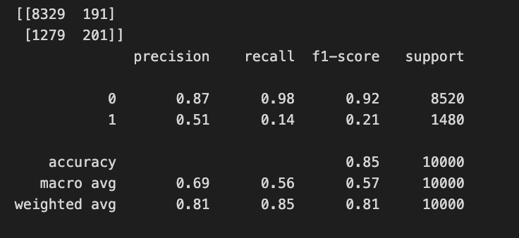
Key Results
Accuracy: 85%
Precision (booking = 1): 51%
Recall (booking = 1): 14%
Top Features:
purchase_lead
route
sales_channel_Online
wants_preferred_seat
booking_origin

Slide 4
Insights
The model is highly confident in predicting non-bookers (Class 0)
Struggles with recall for actual bookers (Class 1), likely due to class imbalance
Key behaviors like booking lead time and preferred services strongly influence outcomes
Recommendations
Focus marketing on customers with early booking lead time
Encourage use of add-on services like preferred seats and meals
Use top routes and booking origins to create personalized campaigns

